Slide 1
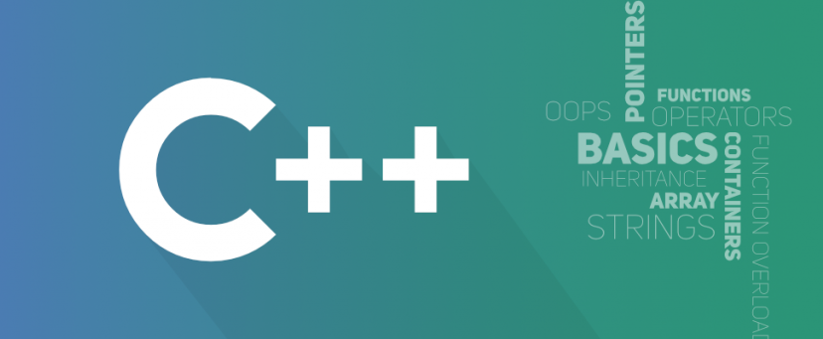
Object Oriented Programming
António J. R. Neves
DETI/UA
Sessão 3

Slide 2
Contents
Pointers and References
Functions
Parameters and arguments
Function Overloading
Function Templates
Streams and files
fstream, ifstream, ofstream
Formatted I/O
Binary I/O
Catching exceptions with file I/O

Slide 3
Pointers
A pointer is a variable that stores the memory address as its value.
Very often the only efficient way to manage large volumes of data is to manipulate not the data itself but pointers to the data (ex: sort large structures, pass data to a function, etc.).
A pointer represents both the address and the type of an object or function.
A simple example:
int iVar = 77;
int *iPtr; // Declare iPtr as a pointer to int.
iPtr = &iVar; // iPtr now “points” to the variable iVar
*iPtr = 88; // Value pointed by iPtr is changed (iVar)
The asterisk (*) means “pointer to.” The type int is the type of object that the pointer iPtr can point to. The ampersand (&) here means: get the address of the variable (in this case iVar).

Slide 4
References
A reference variable is a "reference" to an existing variable, and it is created with the & operator
A simple example:
string food = "Pizza"; // food variable
string &meal = food; // reference to food
Now, we can use either the variable name food or the reference name meal to refer to the food variable:
cout << food << "\n"; // Outputs Pizza
cout << meal << "\n"; // Outputs Pizza

Slide 5
Functions
All the instructions of a C++ program are contained in one or more functions.
main() is a special function: it is the entry point of the program (this function is implicitly called when the program starts).
You can also create your own functions to perform certain actions: each function performs a certain task.
int main(void) // function definition
{
double x = 9.0;
double y = sqrt(x); // example of a function call
double z = sqrt(2.0 * x); // another function call
return 0;
}
Every function is defined exactly once. A program can call a function as many times as necessary (as sqrt in the previous example).

Slide 6
Functions
A function groups a number of program statements into a unit and gives it a name
This unit can then be invoked from other parts of the program.
The definition of a function consists of a line called the declarator, followed by the function body
When the function is called, control is transferred to the first statement in the function body
The other statements in the function body are then executed, and when the closing brace is encountered, control returns to the calling program
int abs(int x){ // declaration
return (n < 0) ? -n : n;
}

Slide 7
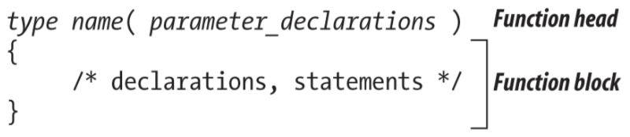
Function Definition
The definition of a function consists of a function head and a function block.
The function head specifies the name of the function, the type of its return value, and the types and names of its parameters, if any.
The return type may be void or any object type except arrays or functions. However it can return a pointer to a function or a pointer to an array.
The parameters declaration is a comma-separated list of variable declarations.
The statements in the function block specify what the function does.

Slide 8
Function Prototypes
A function can also be declared without being defined; it must still be defined elsewhere, perhaps later in the file.
The declaration only is a so-called function prototype. It is a copy of the function head, followed by a semicolon (;).
double cylinderVolume( double r, double h ); // declaration
When a function is used in a source code file before it is defined, in the C/C++ programming language it is necessary to provide a prototype of the function before it is first used; it must match the function head of the actual definition.
double cylinderVolume( double r, double h ) { // definition
const double pi = 3.14159265358979324;
return pi * r * r * h;
}

Slide 9
Function Parameters
The parameters of a function are ordinary local variables.
They are created and initialized with the values of the corresponding function arguments when a function call occurs: this is called “call by value”.
Their scope is the function block.
A function can change the value of a parameter without affecting the value of the argument in the context of the function call.
double factorial( unsigned int n ) {
double f = 1.0;
while(n > 1)
f *= (double)(n--);
return f;
}
factorial modifies its parameter n.

Slide 10
Function Parameters (example)
The following function swaps the values of its arguments (but only inside the function).
void bad_swap( int x, int y ) {
std::cout << "x=" << x << "y=" << y << std::endl;
int tmp = x;
x = y;
y = tmp;
std::cout << "x=" << x << "y=" << y << std::endl;
}
if i=3 and j=7 then bad_swap(i,j) prints:
x=3 y=7
x=7 y=3
After the bad_swap function call the value of i is still 3 and the value of j is still 7.

Slide 11
Function Parameters (example)
Using pointers the situation is different:
void good_swap( int *xPtr, int *yPtr ) {
std::cout << "*xPtr=" << *xPtr;
std::cout << "*yPtr=" << *yPtr << std::endl;
int tmp = *xPtr;
*xPtr = *yPtr;
*yPtr = tmp;
std::cout << "*xPtr=" << *xPtr;
std::cout << "*yPtr=" << *yPtr << std::endl;
}
if i=3 and j=7 then good_swap(&i,&j) prints:
*xPtr=3 *yPtr=7
*xPtr=7 *yPtr=3
just like bad_swap did. After the good_swap function call, however, the value of i is now 7 and the value of j is now 3 (the memory regions pointed to by the two pointers were swapped, the pointers themselves were not changed).

Slide 12
Passing Parameters by Reference
You can also pass a reference to the function. This can be useful when you need to change the value of the arguments (as an alternative to pointers)
void swapNums(int &x, int &y) {
int temp = x;
x = y;
y = temp;
}
if a=3 and b=7 then swapNums(a, b) will change the values of a and b.

Slide 13
Default Parameters
You can use a default parameter value, by using the equals sign ( = )
Example: If we call the following function without an argument, it uses the default value ("Norway")
void myFunction(string country = "Norway") {
cout << country << "\n";
}
int main() {
myFunction("Sweden"); // prints: Sweden
myFunction(); // prints: Norway
myFunction("USA"); // prints: USA
return 0;
}
A parameter with a default value, is known as an "optional parameter". From the example above, country is an optional parameter and "Norway" is the default value.

Slide 14
Recursive function calls
A function may call itself (if so, it is a recursive function).
A recursive function cannot call itself for ever (stack overflow); it must contain a test to stop the recursion.
An example:
double factorial(unsigned int n) {
if(n < 2)
return 1.0; // 0! and 1! are equal to 1.0
return (double)n * factorial(n - 1);
}
factorial(3) calls
factorial(2), which in turn calls
factorial(1), which
does not call factorial anymore

Slide 15
Function Scope and Stack
All programs have a special memory area, called the stack.
The stack is used to store the values of all arguments and local variables of the functions that are called.
In most computer architectures, the stack grows downwards (towards lower addresses).
The processor has a special register (the stack pointer), that points to the last memory position occupied by the stack.
When a function is called, the stack pointer is decreased to reserve memory to store the value of all its arguments.
Each argument (in general, an expression), is evaluated and its value is placed in its position in the stack.
Automatic variables (of the function), are also placed in the stack.
When the functions returns, the stack pointer is increased, to free the memory used by its arguments and automatic variables.

Slide 16
Overloaded Functions
An overloaded function appears to perform different activities depending on the kind of data sent to it
The compiler uses the function signature - the number of arguments, and their data types- to distinguish one function from another
Example:
void repchar();
void repchar(char);
void repchar(char, int);
Which one of these functions will be called depends on the number of arguments supplied in the call
The compiler can also distinguish between overloaded functions with the same number of arguments, provided their type is different

Slide 17
Function Templates (1)
Rewriting the same function body over and over for different types is time-consuming and wastes space in the listing
If you find you’ve made an error in one such function, you’ll need to remember to correct it in each function body
Function templates is a way to write such a function just once, and have it work for many different data types
The example defines a template version of abs() and then, in main(), invokes this function with different data types
template <class T> T abs(T n) { return (n < 0) ? -n : n; } | int a = -5; long b = -70000L; double c = -9.95 cout << abs(a); cout << abs(b); cout << abs(c);

Slide 18
Function Templates (2)
The key innovation in function templates is to represent the data type used by the function not as a specific type such as int, but by a name that can stand for any type
In the previous example, this name is T (it can be anything we want, like Type, or anyType, ...)
The template keyword signals the compiler that we’re about to define a function template
We will get to keyword class later
The variable following the keyword class (T in this example) is called the template argument
What the compiler does? Code generation doesn’t take place until the function is actually called (invoked) by a statement within the program

Slide 19
Function Templates: Examples
Function Templates with Multiple Arguments
template <class atype>
int find(atype* array, atype value, int size){
for(int j=0; j<size; j++)
if(array[j]==value)
return j;
return -1;
}
More Than One Template Argument
template <class atype, class btype>
btype find(atype* array, atype value, btype size){
for(btype j=0; j<size; j++)
if(array[j]==value)
return j;
return static_cast<btype>(-1);
}

Slide 20
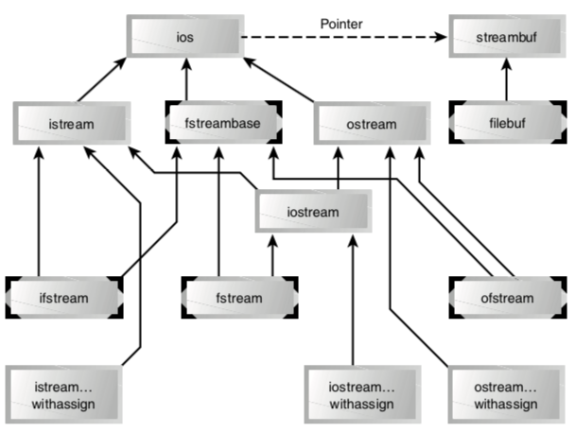
Streams and files
The stream classes are arranged in a rather complex hierarchy
The extraction operator >> is a member of the istream class, and the insertion operator << is a member of the ostream class.

Slide 21
ios
The cout object, representing the standard output stream, which is usually directed to the video display, is a predefined object of the ostream_withassign class, which is derived from the ostream class
Similarly, cin is an object of the istream_withassign class, which is derived from istream
The classes used specifically for disk file I/O are related to the fstream class
The ios class is the base class for the hierarchy - it contains many constants and member functions common to input and output operations of all kinds
The three most important features of ios are the formatting flags, the error-status flags, and the file operation mode

Slide 22
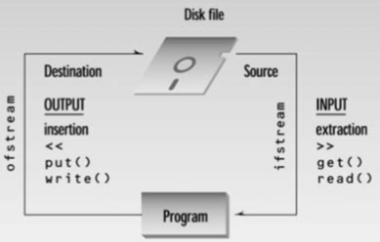
istream/ostream
The istream and ostream classes are derived from ios and are dedicated to input and output, respectively
istream class contains such functions as get(), getline(), read(), and the overloaded extraction (>>) operators
ostream contains put() and write(), and the overloaded insertion (<<) operators

Slide 23
Files
Most programs need to save data to disk files and read it back in
Working with disk files requires another set of classes: ifstream for input, fstream for both input and output, and ofstream for output
Objects of these classes can be associated with disk files, and we can use their member functions to read and write to the files
We can have formatted I/O or binary I/O
In formatted I/O, numbers are stored on disk as a series of characters
In binary I/O data are stored as they are in the computer’s memory

Slide 24
Examples
char ch = 'x';
int j = 77;
double d = 6.02;
string str1 = "Kafka";
string str2 = "Proust";
ofstream outfile("fdata.txt");
outfile << ch
<< j
<< ' '
<< d
<< str1
<< ' '
<< str2;
outfile.close();
cout << "File written\n";
char ch;
int j;
double d;
string str1;
string str2;
ifstream infile("fdata.txt");
infile >> ch
>> j
>> d
>> str1
>> str2;
cout << ch << ...

Slide 25
Embedded Blanks
The technique of our last examples won’t work with strings containing embedded blanks
To handle such strings, you need to write a specific delimiter character after each string, and use the getline() function, rather than the extraction operator
In the next example each line finishes with a newline
ofstream ofs("names.txt");
ofs << "Ana Maria" << endl
<< "Joana Fonseca" << endl
<< "Elena Maria" << endl
<< "Maria Joana" << endl;
ofs.close();
ifstream ifs("names.txt");
while(!ifs.eof()){ //(ifs.good())
string s;
getline(ifs, s);
cout << s << endl;
}
ifs.close();

Slide 26
Binary files
We need to use two new functions: write(), a member of ofstream; and read(), a member of ifstream
These functions think about data in terms of bytes (type char)
They don’t care how the data is formatted, they simply transfer a buffer full of bytes from and to a disk file
The parameters to write() and read() are the address of the data buffer and its length
The address must be cast, using reinterpret_cast, to type char*, and the length is the length in bytes (characters), not the number of data items in the buffer
When open the file, we must use the ios::binary argument in the second parameter

Slide 27
Example
// Initialize an array with some ints
const int ARR_SIZE = 6;
int out_arr[ARR_SIZE];
for(int i = 0 ; i < ARR_SIZE ; i++)
out_arr[i] = 10 * i;
// Write the data on file
ofstream ofsb("data.bin", ios::binary);
ofsb.write(reinterpret_cast<char*>(out_arr), ARR_SIZE * sizeof(int));
ofsb.close();
// Read the data from the file
int in_arr[ARR_SIZE];
ifstream ifsb("data.bin", ios::binary);
ifsb.read(reinterpret_cast<char *>(in_arr), ARR_SIZE * sizeof(int));
ifsb.close();
for (auto num: in_arr)
cout << num << endl;

Slide 28
Exceptions
Exceptions provide a convenient, uniform way to handle errors that occur in runtime
They are caused by a wide variety of exceptional circumstance, such as running out of memory, not being able to open a file, trying to initialize an object to an impossible value, or using an out-of-bounds index to a vector
The exception mechanism uses three new C++ keywords: throw (later), catch, and try
// Example: trying to read from a file that does not exist
try {
std::ifstream ifs("filename"); // filename does not exist
ifs.exceptions(std::ifstream::failbit);
// ...
ifs.close();
} catch (std::exception& e) {
std::cout << "Could not read from file! Found exception: "
<< e.what() << std::endl;
}

